Slide 1

NDMA C-UAS Operators
Extended VMS Operation 1

Slide 2
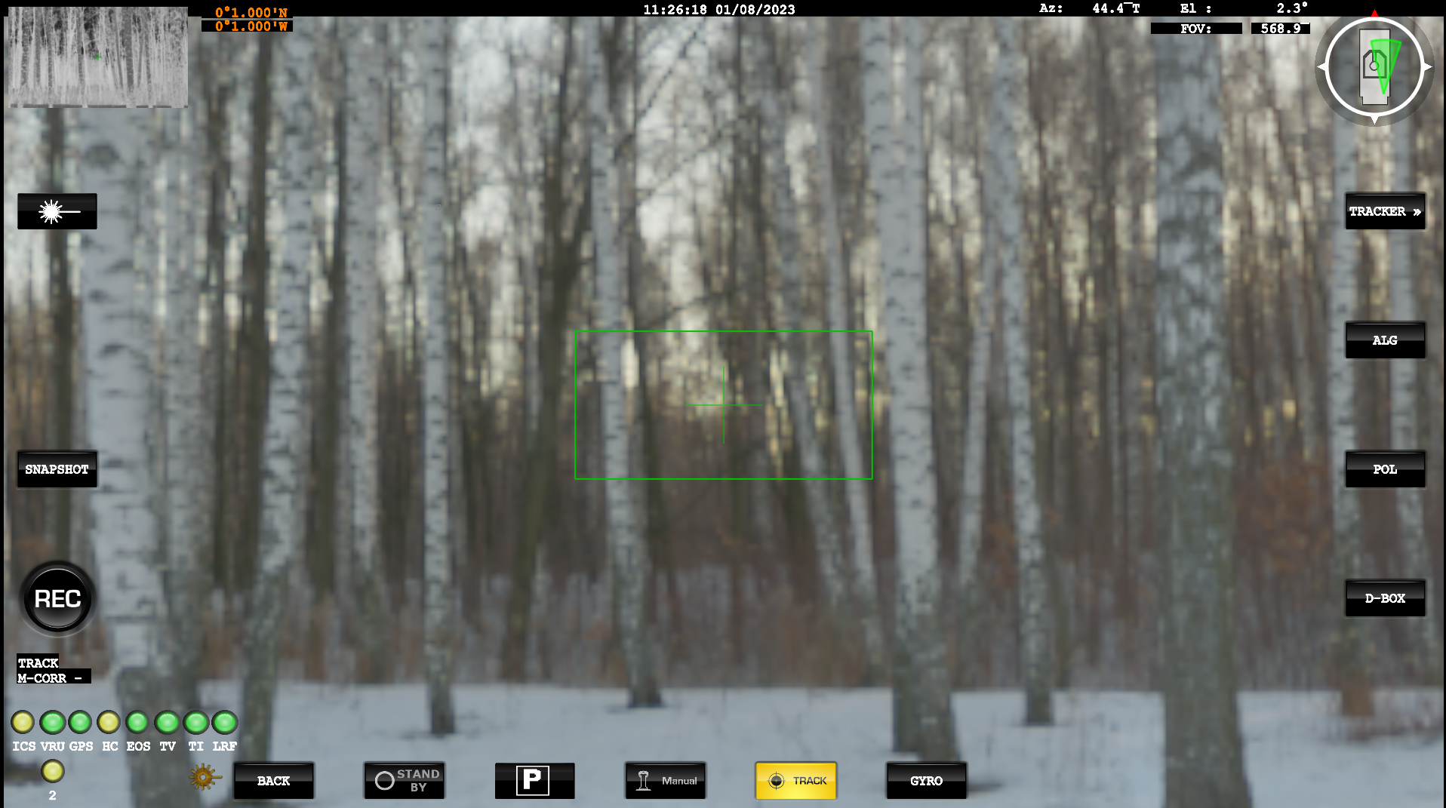
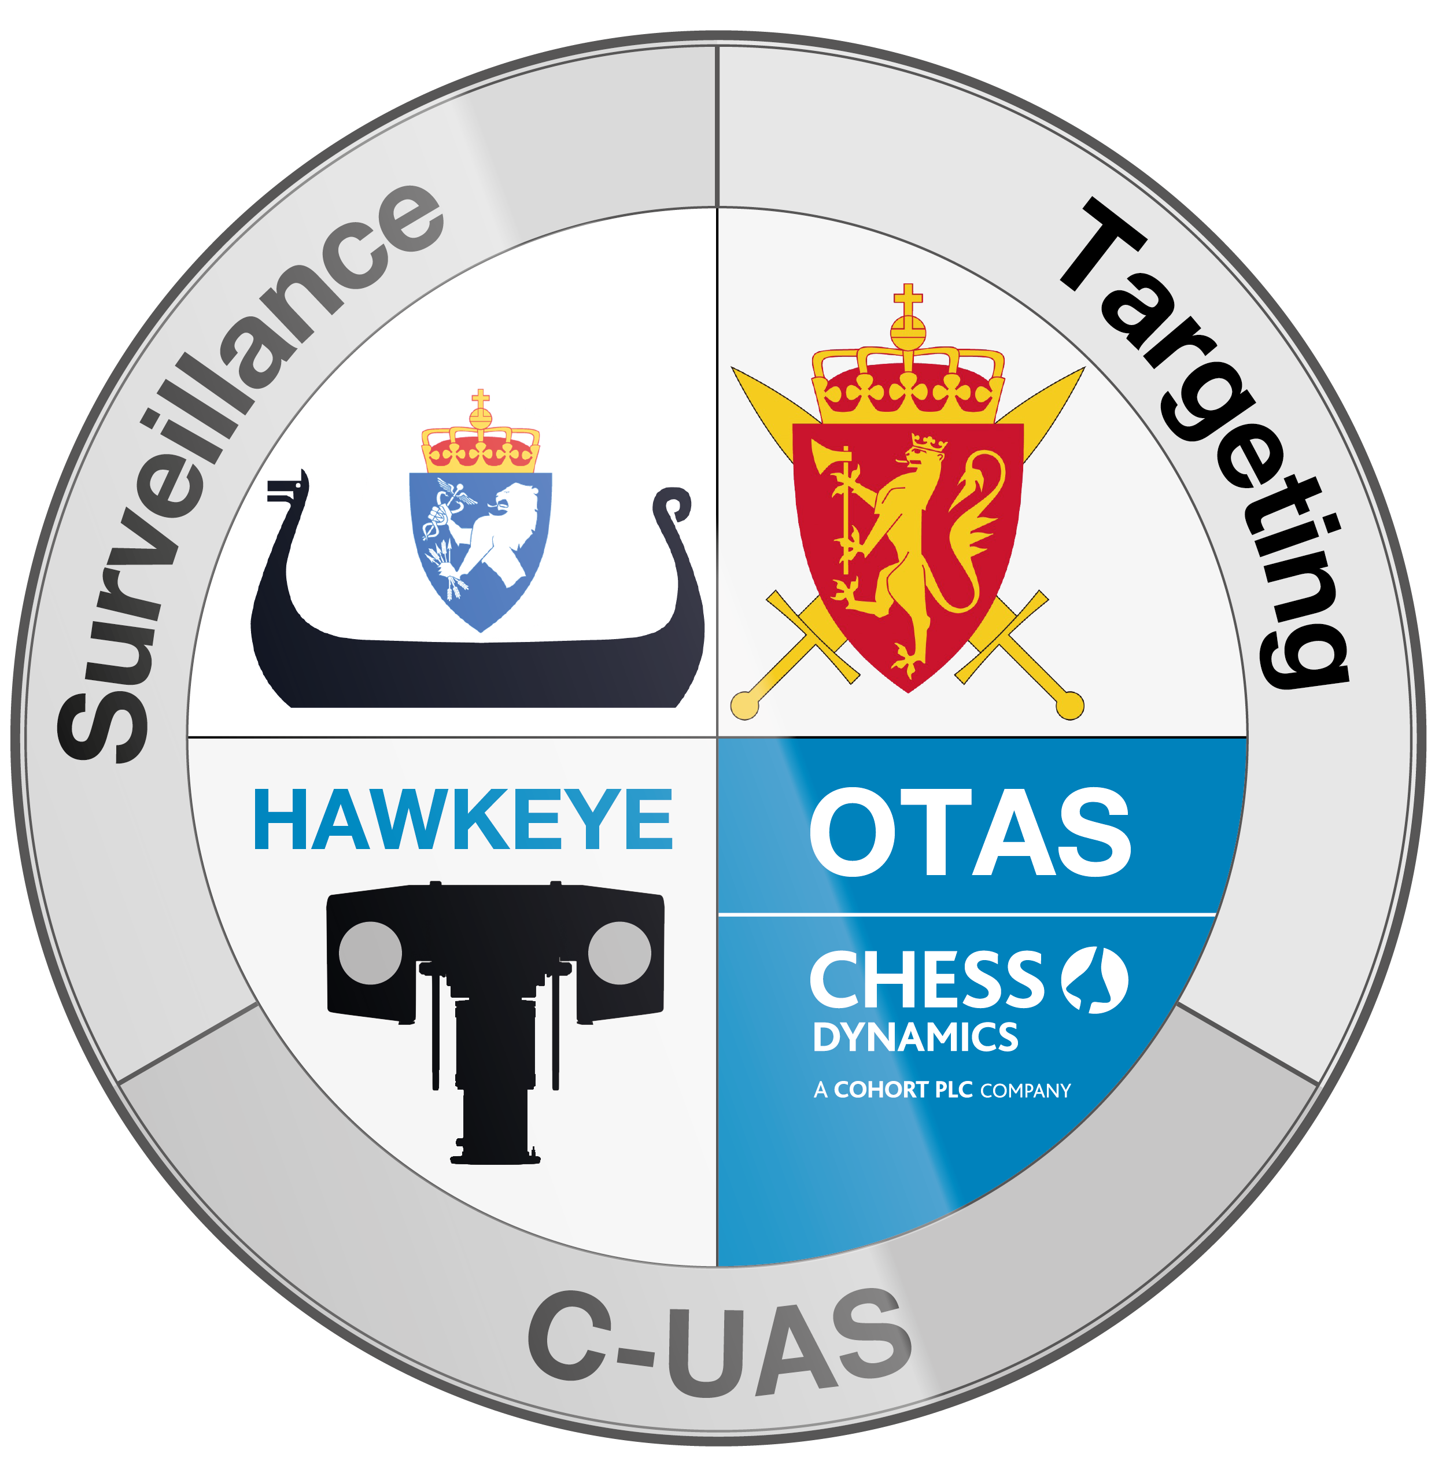






Mode selection
The system has several modes selected by the buttons at the bottom of the screen. Buttons are highlighted when active.
Button | Mode | Description
 | Standby (STBY) | Commands the platform to standby with the brakes applied and the motors switched off. Press the button twice to power off the console.
 | Manual (MAN) | Releases the brakes and allows the EOD to be controlled from the gamepad controller.
 | Track (TRK) | Press once to enter manual (target acquisition) mode, during which the gamepad controller can be used to control the pointing angle of the EOD. Press again to select the tracking mode, which follows items selected by the user. This mode can be used with both TV and the TI cameras. The joystick can also be used to toggle between manual and track mode. Selects auto track mode where the EOD is controlled by the automatic video tracker.
Notes:
We will go into to further tracking control later in the course.

Slide 3
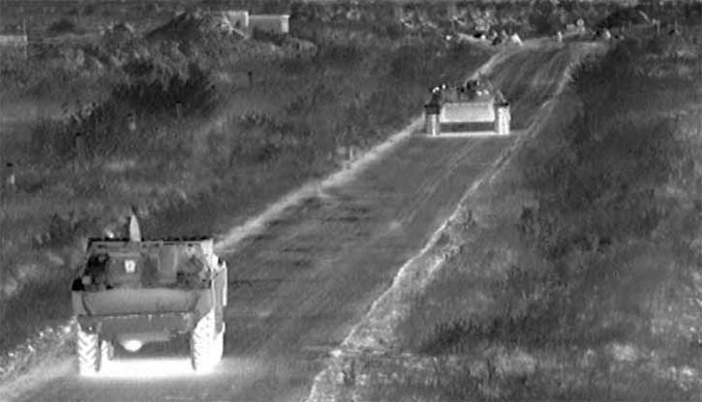
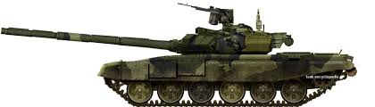
Ext VMS Operation - Video Tracker
The automatic video tracker can be engaged to take control of the EOD and maintain a visual tracking lock on a selected target in the primary sensor.
The video tracker is used to indicate potential targets in manual mode, and then follow the selected target in track mode.
The video tracker can toggle between 3 modes of operation:
On-screen | Description | Best for
M – Corr (Manual Correlation) | The tracker will track the central area of track window. | Close up images of stationary land targets.
A – Corr (Automatic Correlation) | in manual (acquire target) mode tracker will highlight the closest high contrast ‘blob’ to the boresight. In track mode a pattern matching algorithm will be used to follow the target. | Small targets, larger targets at greater distance.
C-DEFT | Deep Embedded feature tracking. Includes classification | All Items

Slide 4

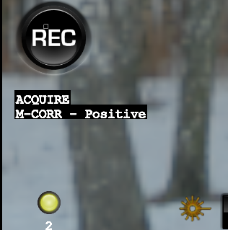
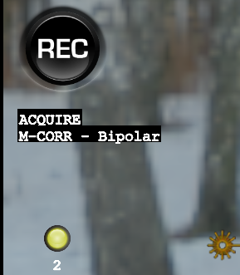
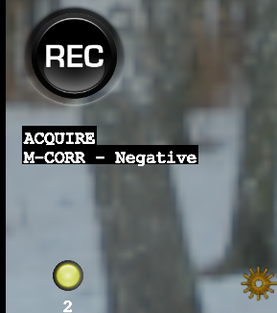
Ext VMS Operation - Video Tracker
On-screen | Description | Best for
Positive | The video tracker will highlight objects that are brighter than the background. | Targets in the IR camera which are hotter than the background.
Negative | The video tracker will highlight objects that are darker than the background. | Targets in the IR camera which are cooler than the background.
Bipolar | The video tracker will highlight objects that are brighter or darker than the background. | Targets in the TV camera.
Notes:
Tracker Polarity can be changed with the “POL” polarity button, it cycles through Positive, Negative and Bi-Polar

Slide 5
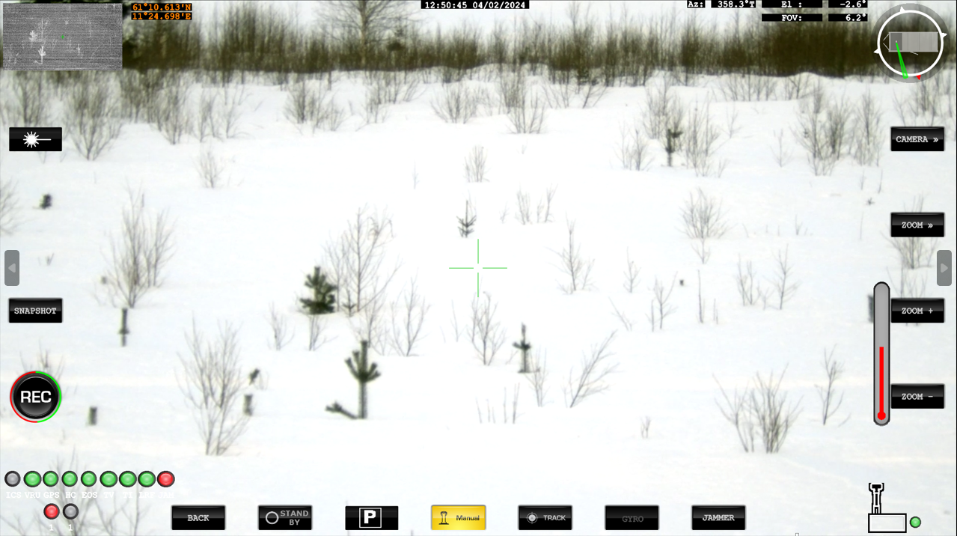
Ext VMS Operation - Tracker mode
Track mode is indicated by the green on-screen symbology. In this mode the pointing angle of the camera is automatically controlled by the video tracker. The area of operation of the video tracker is indicated by the large green gate.
Press the Track mode button or the gamepad controller to return the system to manual (acquire target) mode.
The sensor controls are active in Track mode, allowing the operator to zoom-in to visually confirm whether the object is actually a threat and to take the appropriate action.
Changing the primary sensor does not affect the automatic video tracker, which continues to use which ever sensor was selected on entry to track mode.
In track mode the measured target position is used to provide electronic stabilisation of the image from the sensor currently being tracked.

Slide 6



Ext VMS Operation - Video Tracker
Button | Action | Description
 | Tracking algorithm | Cycles between the centroid and correlation tracking algorithms. The current tracking algorithm is displayed through on-screen symbology.
 | Gate size | Changes the size of the video tracker gate in manual (acquire target) mode. The size of the gate should match that of the target.
 | Track polarity | Selects the polarity of the target highlighted by the video tracker. Current polarity is shown in the on-screen symbology and can be switched between “Positive”, “Negative” and “Bipolar”.
Notes:
Confirm this is the correct location of button controls

Slide 7
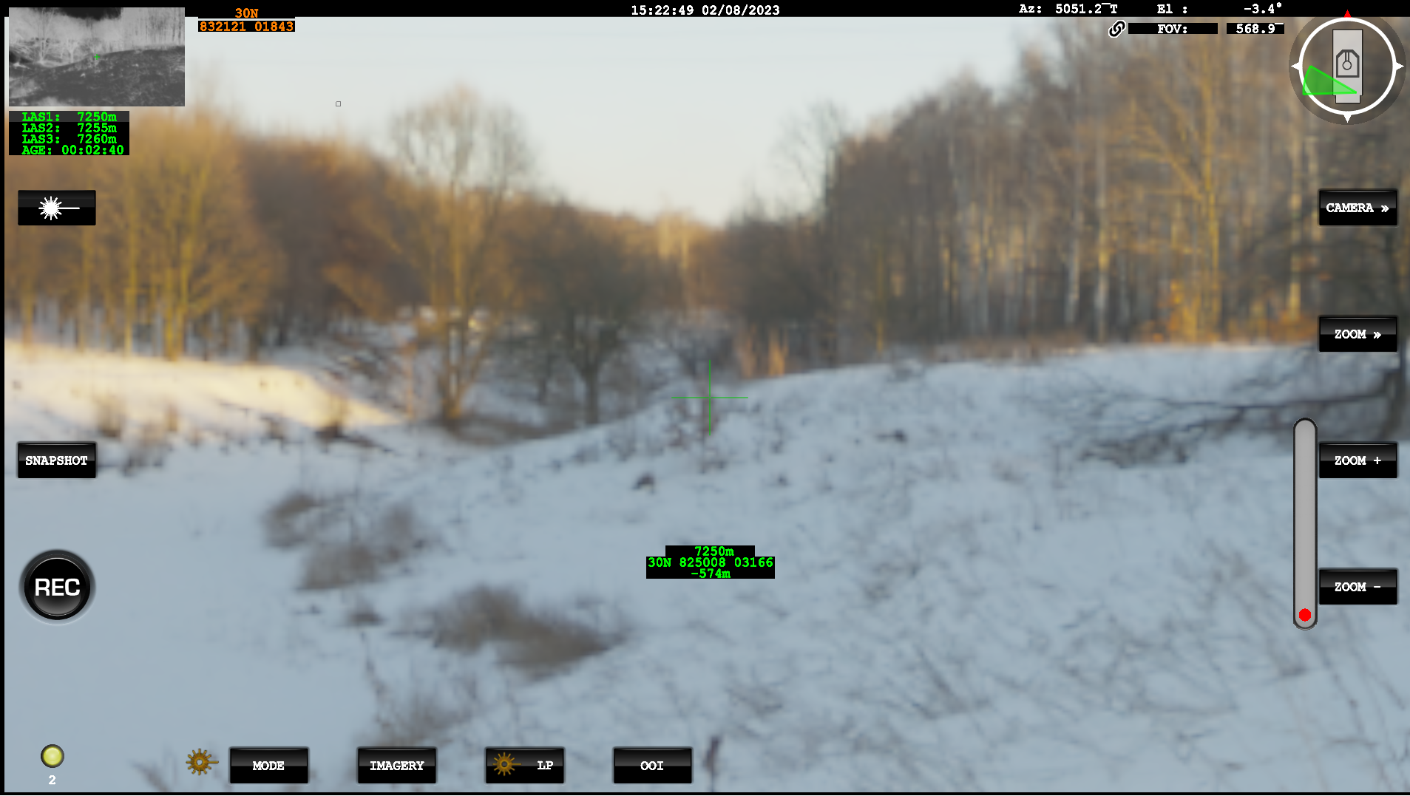
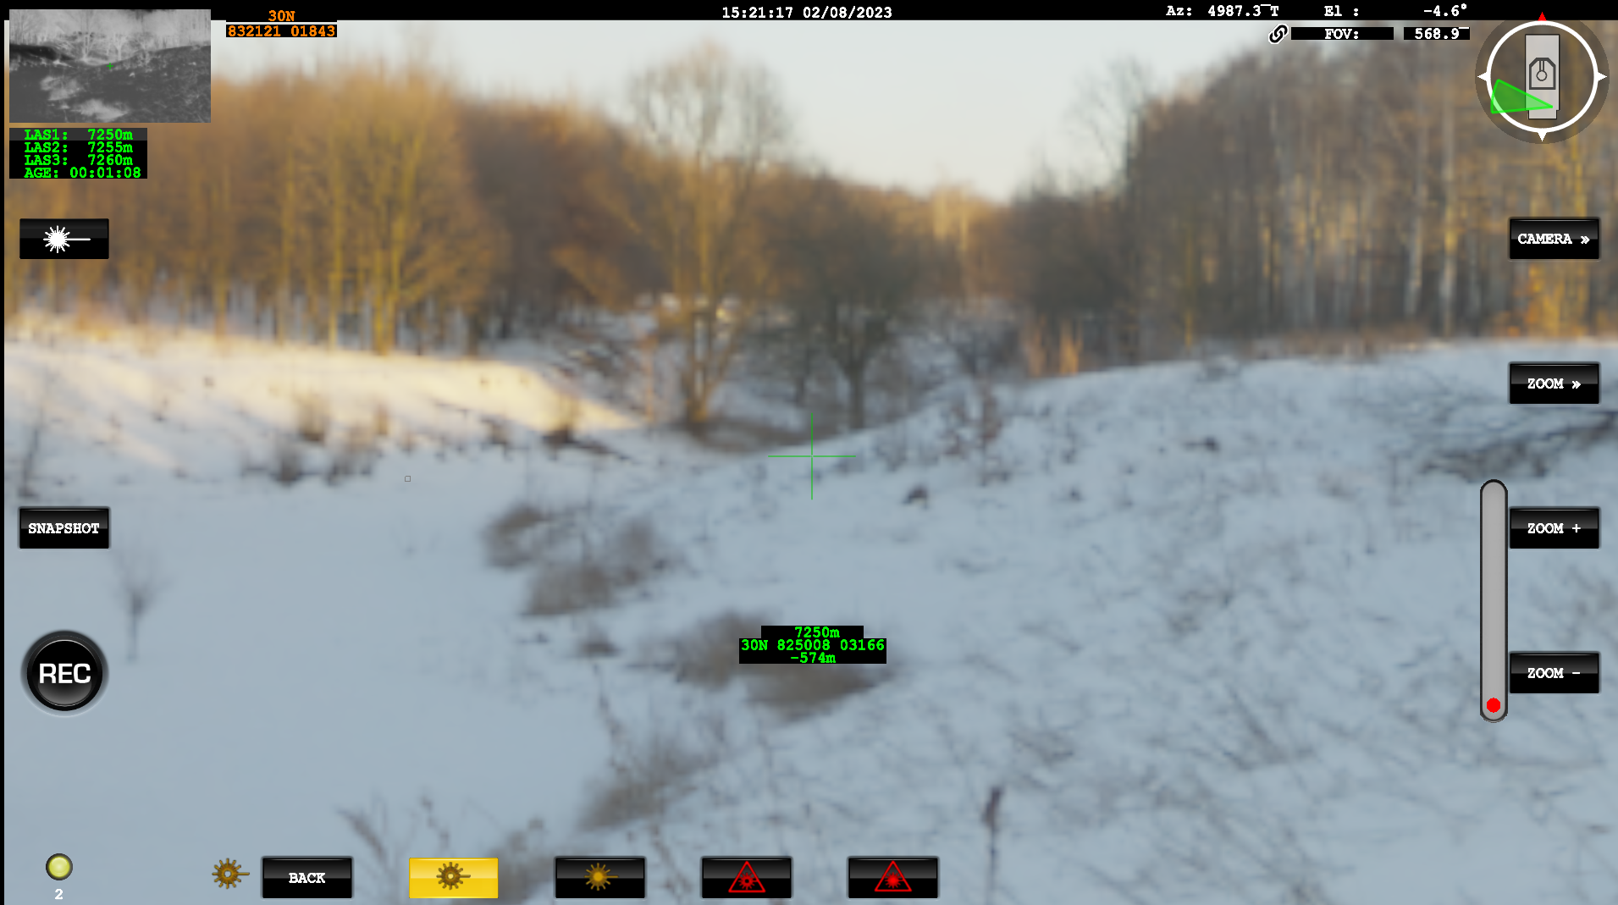
Ext VMS Operation – Laser Pointer
Notes:
Laser Pointer can be accessed in this menu
When selected, brings up this menu, details of the modes on the next slide

Slide 8




Ext VMS Operation – Laser Pointer
Button | Mode | Information
 | Low Power IR | Class 1 – 840nm Laser
 | High Power IR | Class 3B – 840nm Laser
 | Low Power Visible Green | Class 2 – 650nm Laser
 | High Power Visible Green | Class 3B – 840nm Laser

Slide 9
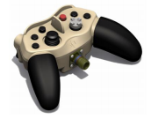
Laser Range Finder (LRF)
The LRF can be operated in manual mode, target designation mode and track mode.
The joystick right button is used to fire the LRF. Following a successful measurement, range is displayed on the screen.
Other laser status messages
Message Text | Description
READY | Laser is ready to fire
NO TRANSMISSION | Error on laser fire request, no light transmitted
NO RETURN | Error on laser fire request, no return received
SHORT RANGES | Error on laser fire request, all returns received are less than the low end of the defined range gate
ERROR | Other error on laser fire request
CHARGING | Laser is charging after previous transmission
WARNING | Laser is reporting warning states

Slide 10
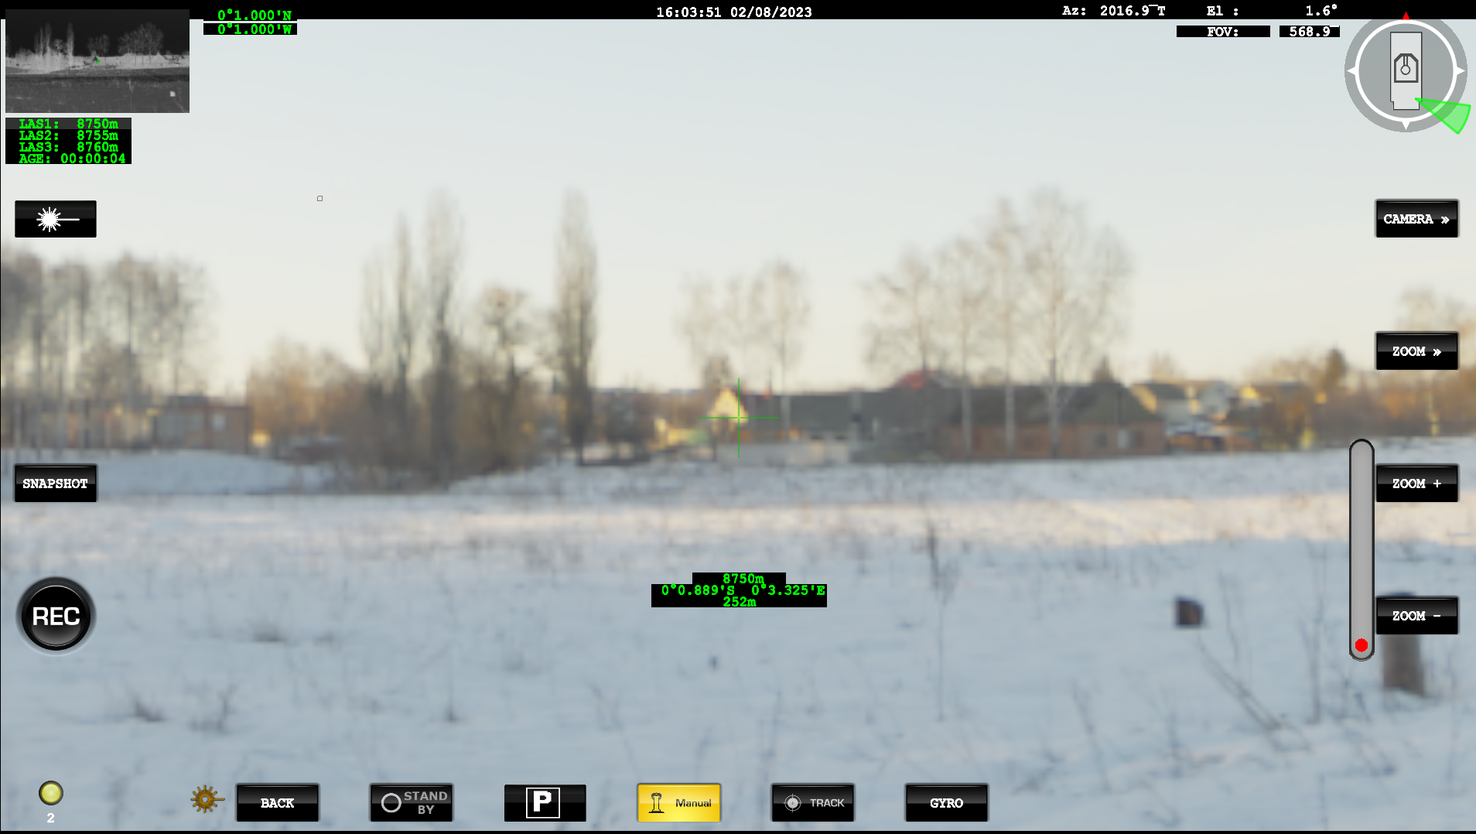
Ext VMS Operation – Laser Range Finder
Notes:
On the Screen it will show the Lat/Long and Distance to Target, along with Relative height.
This is all based on Data from the GNSS and IMU information.
This shows the Last 3 returns and the “age” ie when the last measurement was taken.

Slide 11


Ext VMS Operation - Digital video recording
The control computer provides real time H.264 compression and recording of the IR and TV video channels at full D1 resolution and frame rate. A data stream containing date, time, and whatever sensor metadata is available is recorded in parallel to the same file as the video. A minimum of 20 hours recording time is available for each channel.
Recording video playback
Press the Record button to record video for both channels. The button is highlighted while video is being recorded.
Press the Record button again to stop recording video for both channels.
By default, recorded video is saved to the OTAS shared directory.
Video and associated metadata can be retrieved and viewed by the BMS application.
.
Notes:
The coloured Ring shows

Slide 12
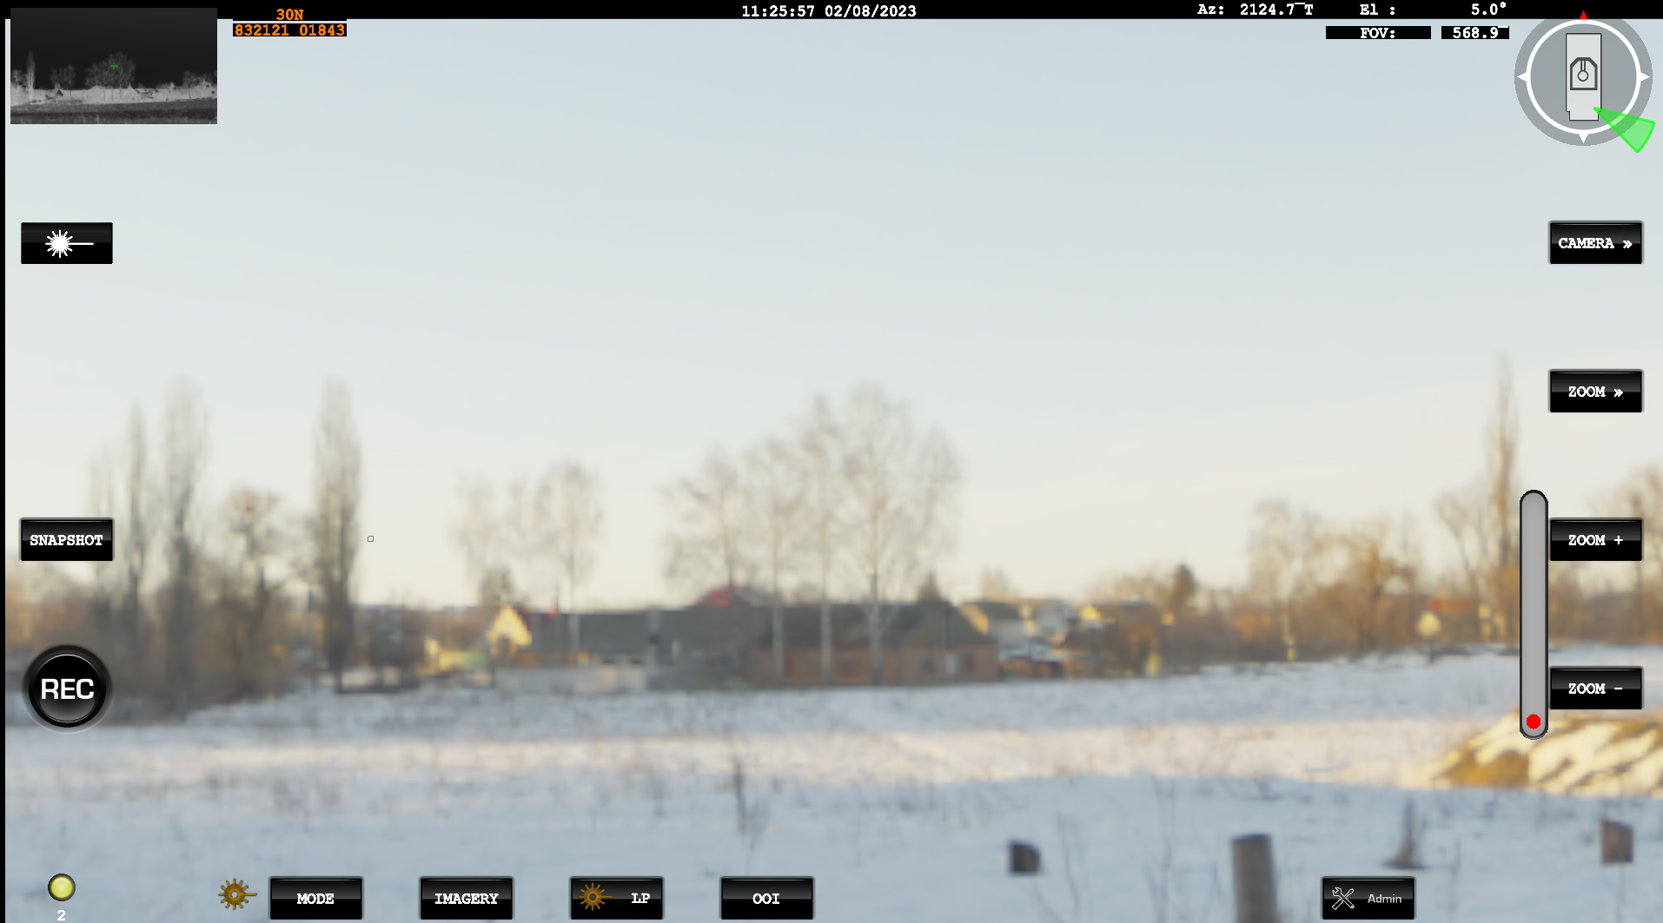
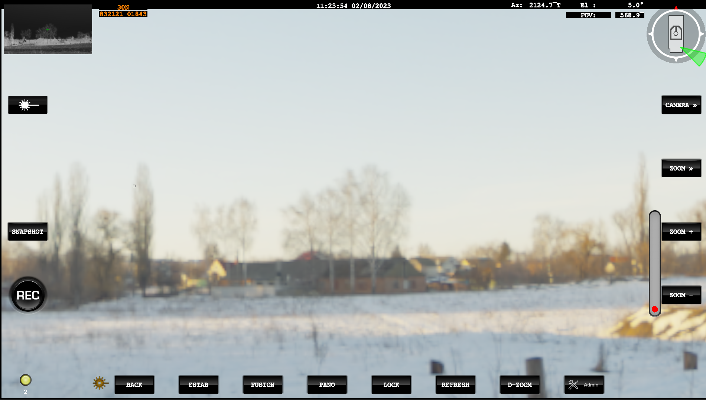
Ext VMS Operation – Imagery
Notes:
Imagery Controls are accessed through the Soft Keys or screen, which then displays the options available.
Changes and control are Mode dependant.

Slide 13






Ext VMS Operation - Imagery
Button | Action | Description
 | Enable / Disable Estab | Electronic Stabilisation , it will provide a more stable image against small vibrations.
 | Image Fusion | When ON, the video displayed will be a fusion of the daylight TV and TI camera video.
 | Create Panorama | If a Panorama exists, then it will switch the Display On/Off. If no panorama has been created since boot, then a new panorama will be created.
 | Refresh Panorama | Following on from above. If Panorama is on, this will create a new one utilising the camera that is currently in use as primary sensor.
Button | Action | Description
 | Lock | When the Pano image is unlocked it will move with the cameras as it rotates. When locked, box showing the camera position will stop as it reaches the end of the image and the image will no longer match the camera viewpoint.
 | D-Zoom | This will cycle through the available Digital zoom Levels.
Notes:
To refresh the pano, this can also be achieved using a right Mouse Click on the Pano strip.
The Fusion will overlay the cameras onto each other.
LOCK:: The locked strip functionality can be useful if you move the cameras to examine a location but want to be able to return to your starting point quickly as necessary. A fixed strip allows you to click a point on the strip to easily return the cameras to that location

Slide 14
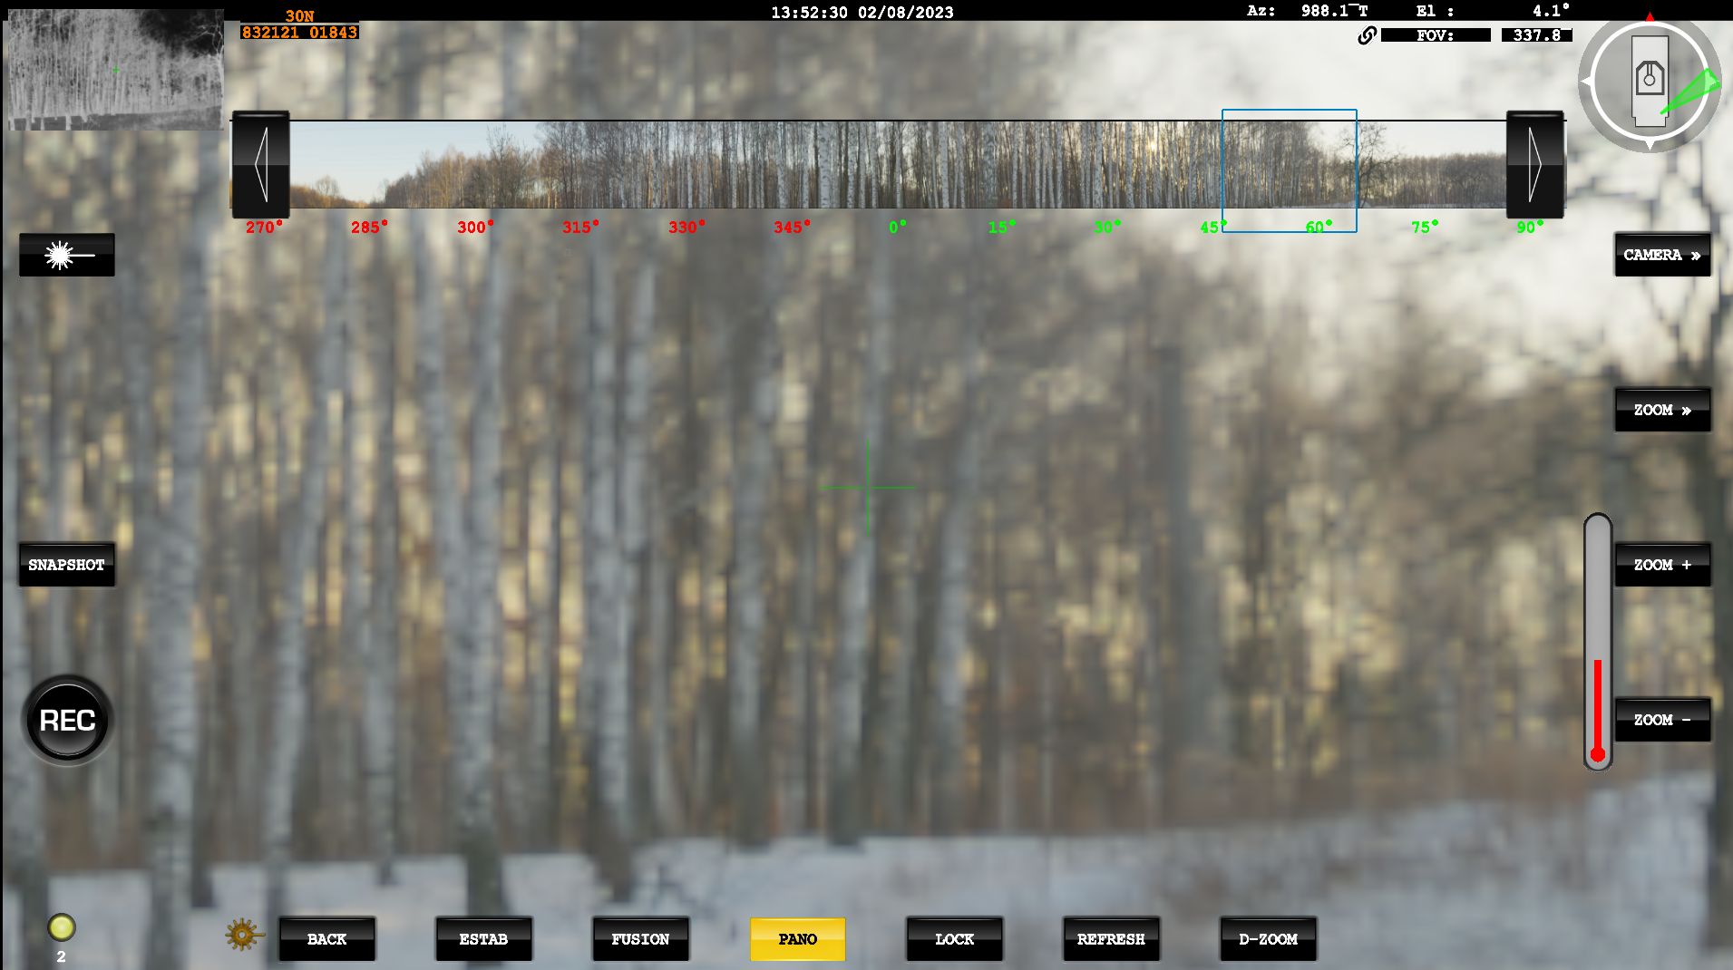
Ext VMS Operation – Panorama
Notes:
Yellow Pano button at the bottom indicates that the image is enabled.
Blue Box indicates where the System is currently looking, where this is unlocked, the Panorama will not move with the EOD.
Therefore this blue box, may not always be visible in the Panaorama strip.
When Locked, this Blue box should always be visible in the Stip Image

Slide 15
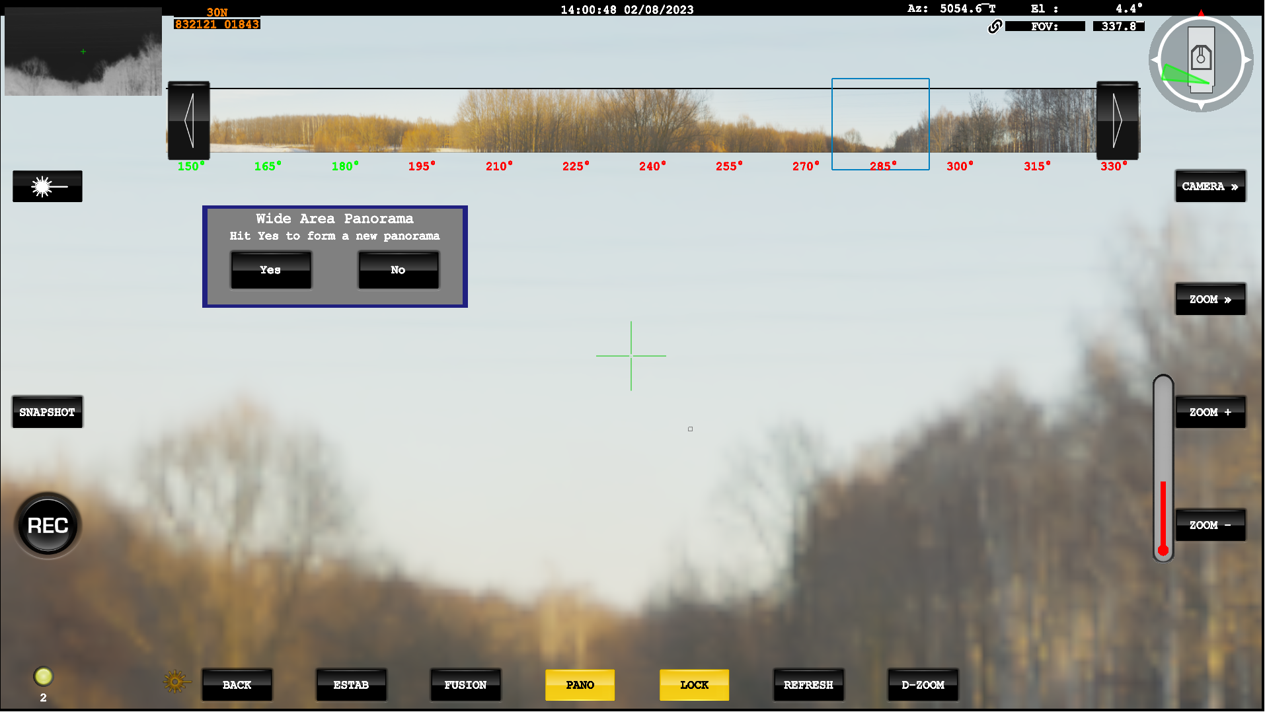
Ext VMS Operation – Panorama
Notes:
If Refresh is selected, then a prompt will appear to ask if you wish to create a new Panaorama.
A Right Mouse click on the strip image it’s self has the same effect.
Selecting “Yes” the system will create a new Pano from the current Primary Sensor.
If the Pano is switched off, then the system will save the last strip image created. This will be lost on a reboot. There is an option to save the Panorama formed and can be reloaded.

Slide 16
Ext VMS Operation – Panorama
The System has the ability to save Panorama
Once Formed, press the Save button and these will be stored. If the VMS is reloaded, they can then be loaded.
Notes:
If Refresh is selected, then a prompt will appear to ask if you wish to create a new Panaorama.
A Right Mouse click on the strip image it’s self has the same effect.
Selecting “Yes” the system will create a new Pano from the current Primary Sensor.
If the Pano is switched off, then the system will save the last strip image created. This will be lost on a reboot. There is an option to save the Panorama formed and can be reloaded.

Slide 17
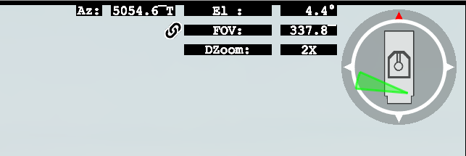
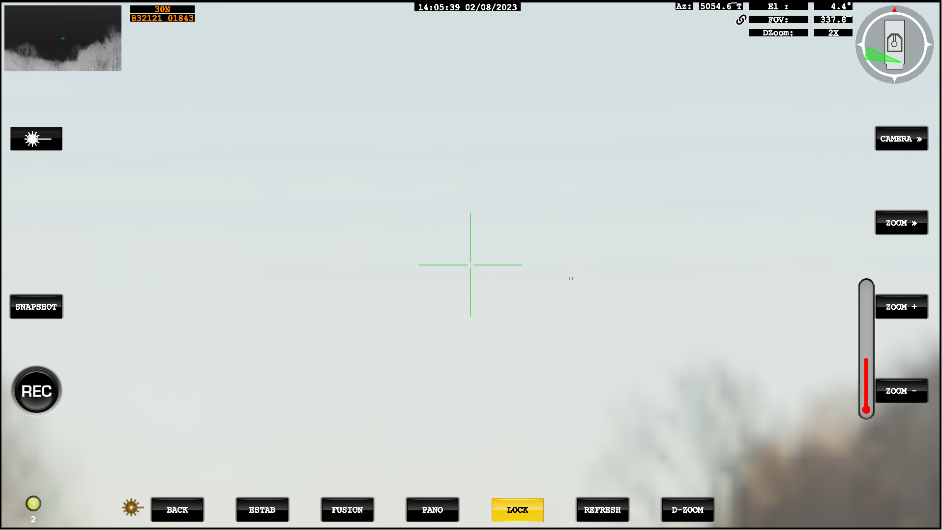
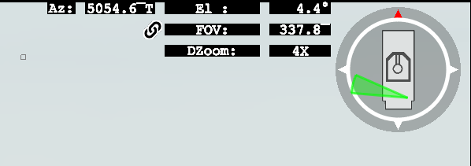
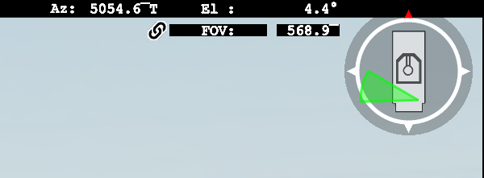
Ext VMS Operation – D-Zoom (Digital Zoom)
Digital Zoom is available in X2 and X4
The current D-Zoom level will be displayed in the top right corner
Pressing the D-Zoom Button will cycle through 2X 4X and None

Slide 18
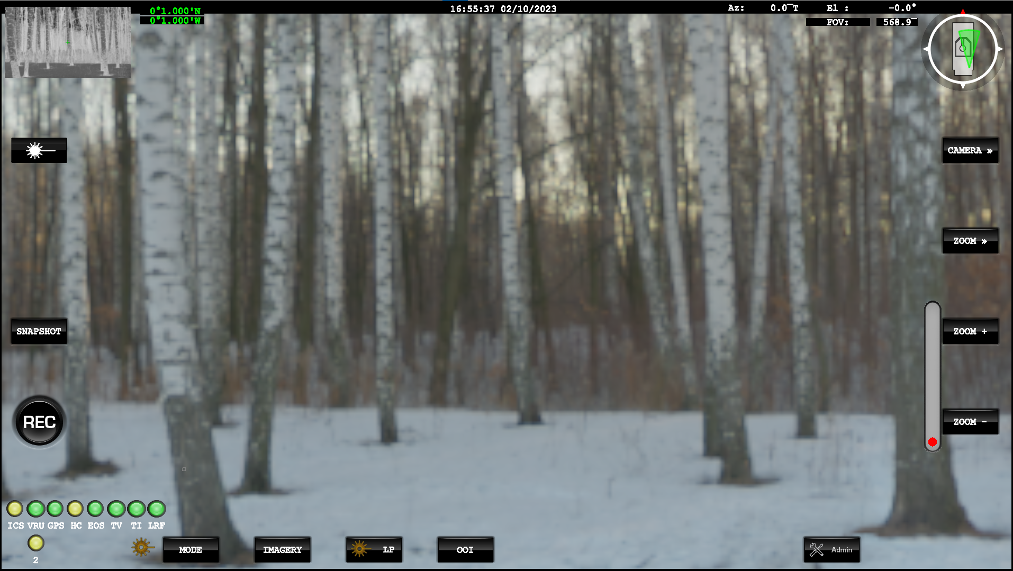
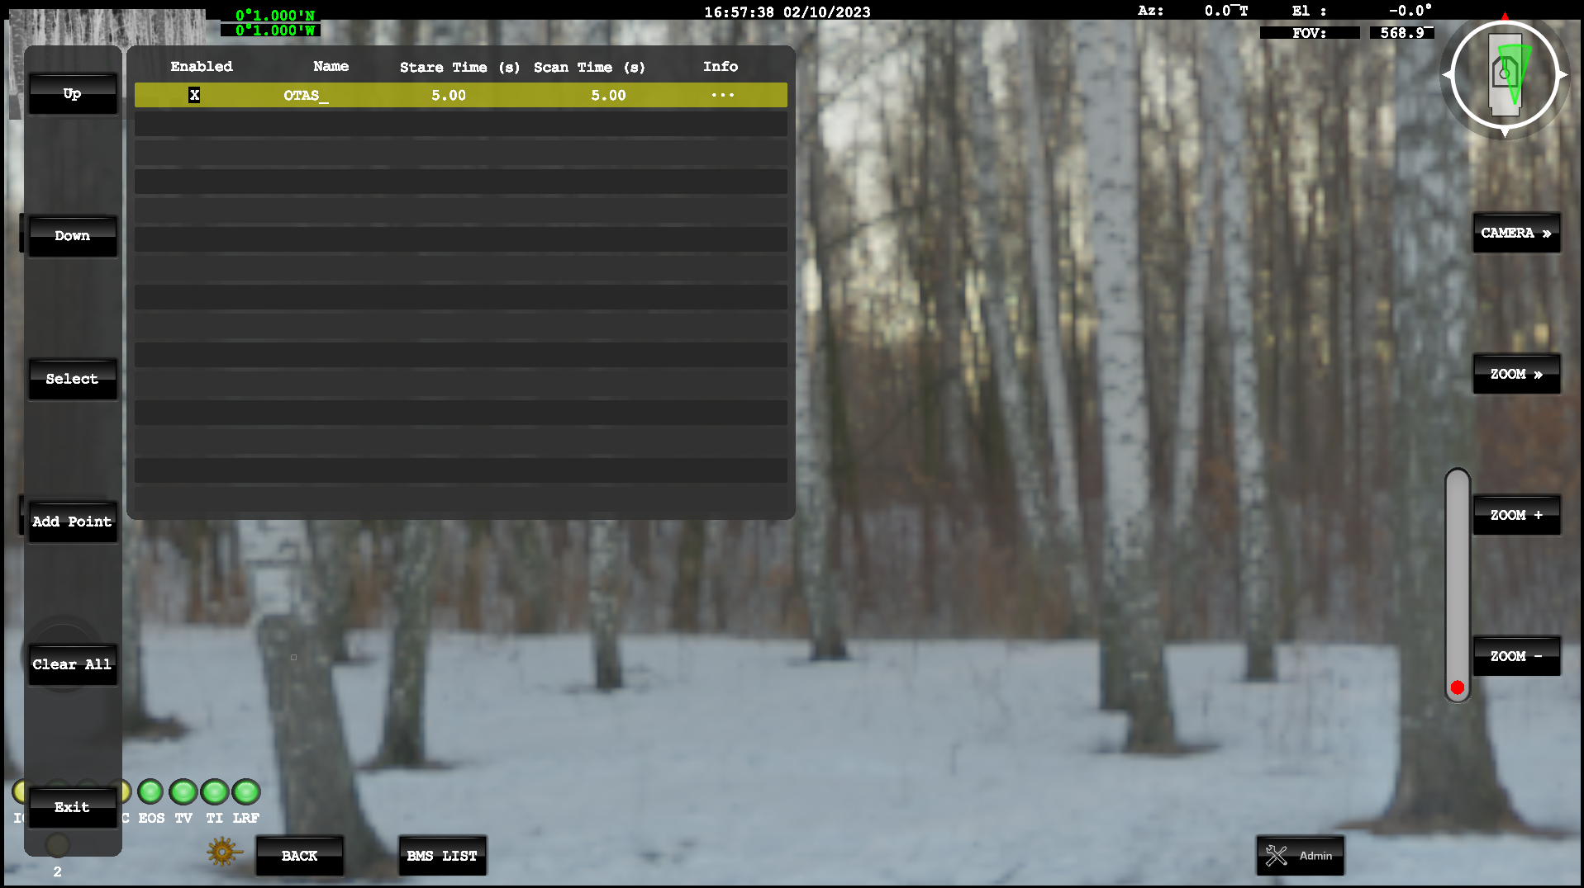
Ext VMS Operation – OOI (Objects of Interest)
Objects of interest can be sent to the system via the BMS or manually entered by the OTAS user.
From the menu, select OOI on the bottom
Select BMS List and the OOI will appear

Slide 19








Ext VMS Operation – OOI (Objects of Interest)
Button | Action | Description
 | Move up the list | This move the selection of a particular point in the list of points
 | Move down the list | This move the selection of a particular point in the list of points
 | Add OOI | Points can be added manually in Geo or Polar format (further information on next slide)
 | Select OOI to Edit | This will select a specific OOI to be either edited or viewed
Button | Action | Description
 | Exits the OOI menu
 | View Selected Target (OOI) | This will slew the system to the currently selected OOI
 | Clear Selected OOI | Clears the currently selected OOI
 | Clear All | Will clear the complete list of OOI

Slide 20
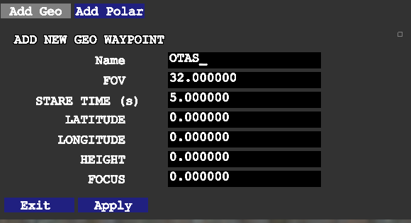
Ext VMS Operation – OOI (Objects of Interest) – Adding Manual OOI
OOI can be added manually in two different formats.
OOI can be added manually using Geo (Geographical) co-ordinates

Slide 21
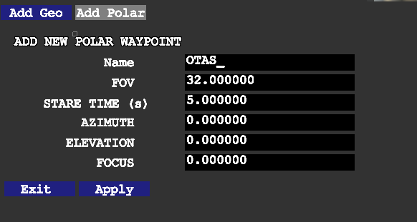
Ext VMS Operation – OOI (Objects of Interest) – Adding Manual OOI
OOI can be added manually in two different formats.
OOI can be added as Polar waypoint, where the user sets the Azimuth and Elevation of the system.

Slide 22
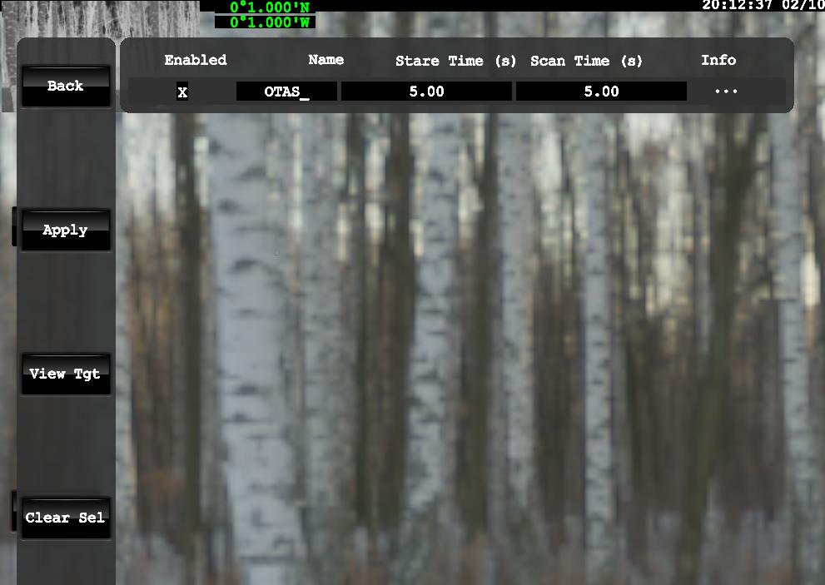
Ext VMS Operation – OOI (Objects of Interest) – Editing OOI
OOI can be edited, viewed or cleared once selected.
If a Target is viewed, the system will slew to it. If zoom level or position is changed, selecting Apply will confirm the changes.

Slide 23
Ext VMS Operation
Questions?

Slide 24
Ext VMS Operation
Template

